Slide 1
Divide and Conquer strategy (Heap Sort)

Slide 2
Overview
• O(n lg n) worst case-like merge sort.
• Sorts in place-like insertion sort.
• Combines the best of both algorithms.

Slide 3
Heap data structure

Slide 4
Example

Slide 5
Example
Given an array of size N. The task is to sort the array elements by using Heap Sort.
Input:
N=10
Arr[]:{16, 4, 10, 14, 7, 9, 3, 2, 8, 1}
Output: 1 2 3 4 7 8 9 10 14 16

Slide 6
Example
Given an array of size N. The task is to sort the array elements by using Heap Sort.
Input:
N = 10
arr[] = {10,9,8,7,6,5,4,3,2,1}
Output:1 2 3 4 5 6 7 8 9 10

Slide 7
Heap property
For max-heaps (largest element at root), max-heap property: for all nodes i ,
excluding the root, A[PARENT(i )] ≥ A[i ].
For min-heaps (smallest element at root), min-heap property: for all nodes i ,
excluding the root, A[PARENT(i )] ≤ A[i ].

Slide 8
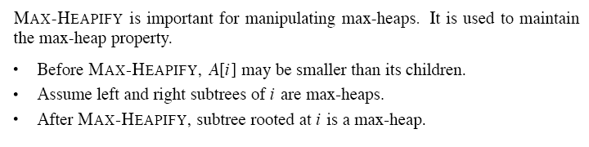
Maintaining the heap property

Slide 10
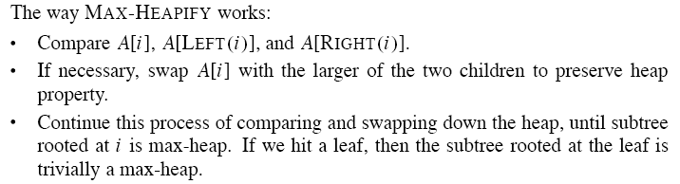

Slide 12
Building a heap

Slide 13
Example
Building a max-heap from the following unsorted array results in the
first heap example.

Slide 15
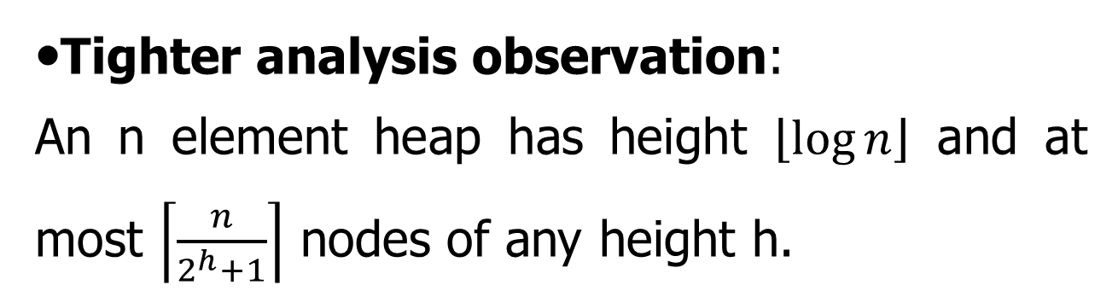
Analysis
• Simple bound: O(n) calls to MAX-HEAPIFY, each of which takes O(lg n) time ⇒ O(n lg n).
•Tighter analysis observation:
An n element heap has height $\left\lfloor \log{n}\right\rfloor$ and at most $\left\lceil \frac{n}{2^{h}+1}\right\rceil$ nodes of any height h.

Slide 16
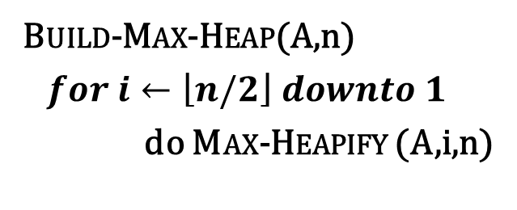
Tighter analysis Proof
Build-Max-Heap(A,n)
$for i←\left\lfloor n/2\right\rfloor downto 1$
do Max-Heapify (A,i,n)
9
6
5
i
0
8
2
1
1 | 2 | 3 | 4 | 5 | 6 | 7 | 8
9 | 6 | 5 | 0 | 8 | 2 | 1 | 3
3

Slide 17
Tighter analysis Proof
For easy understanding, Let us take a complete binary Tree,
The height of a node is the number of edges from the node to the deepest leaf.
The depth of a node is the no of edges from the root of the node.

Slide 18
Tighter analysis Proof
All the leaves are of height 0, therefore there are 8 nodes at height 0.
4 numbers of nodes at height 1.
2 numbers of nodes at height 2.
and one node at height 3.

Slide 19
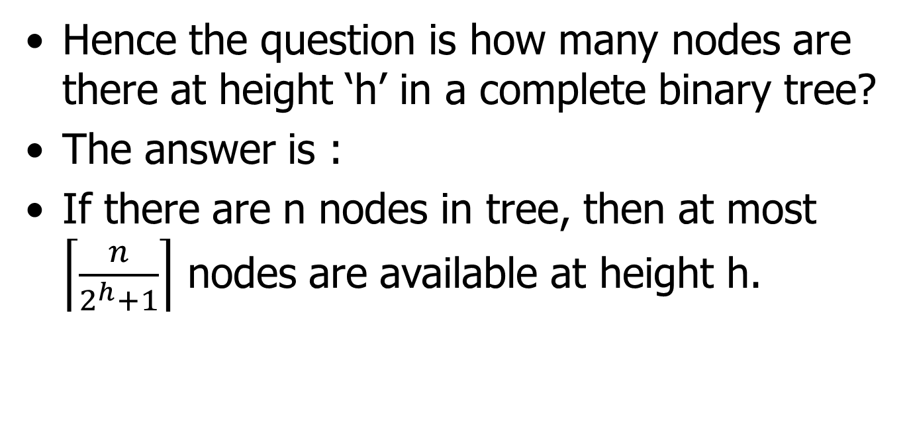
Tighter analysis Proof
Hence the question is how many nodes are there at height ‘h’ in a complete binary tree?
The answer is :
If there are n nodes in tree, then at most $\left\lceil \frac{n}{2^{h}+1}\right\rceil$ nodes are available at height h.

Slide 20
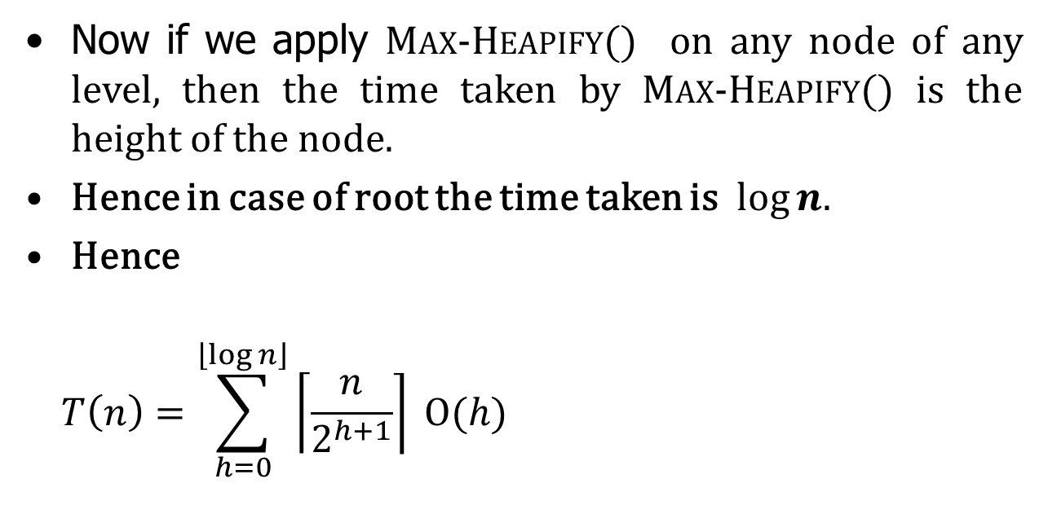
Tighter analysis Proof
Now if we apply Max-Heapify() on any node of any level, then the time taken by Max-Heapify() is the height of the node.
Hence in case of root the time taken is $log⁡n.$
Hence
$$T\left(n\right)=\sum_{h=0}^{\left\lfloor \log{n}\right\rfloor }{\left\lceil \frac{n}{2^{h+1}}\right\rceil }Ο(h)$$
Work done by Max-Heapify() on the number of nodes of height h.

Slide 21
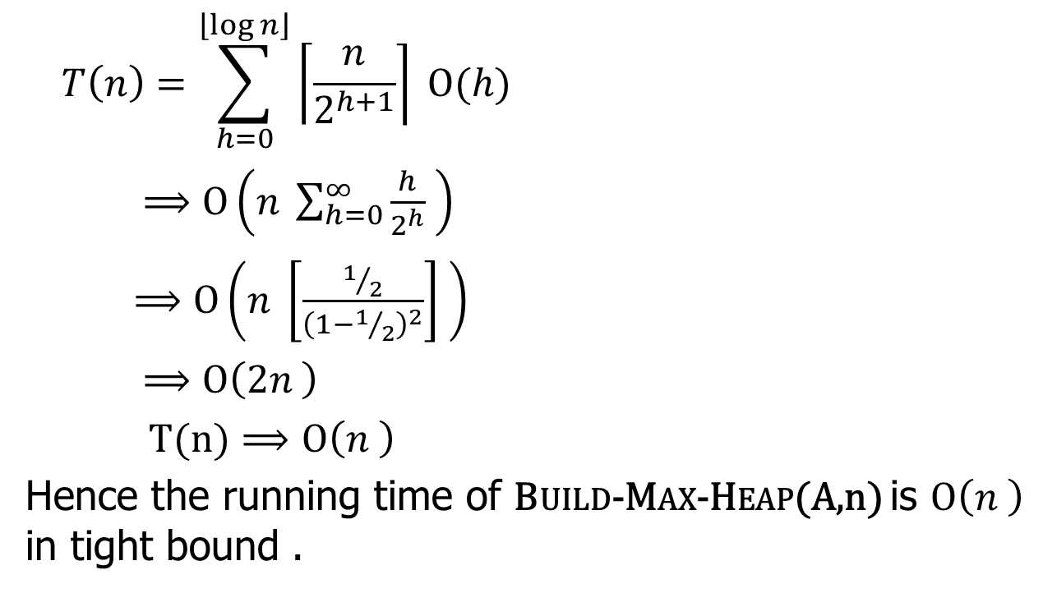
Tighter analysis Proof
$$T\left(n\right)=\sum_{h=0}^{\left\lfloor \log{n}\right\rfloor }{\left\lceil \frac{n}{2^{h+1}}\right\rceil }Ο(h)$$
$⟹Ο\left(n \sum_{h=0}^{∞}{\frac{h}{2^{h}} }\right)$
$⟹Ο\left(n \left[\frac{1/2}{{\left(1−1/2\right)}^{2}}\right] \right)$
$⟹Ο\left(2n \right)$
$T(n)⟹Ο\left(n \right)$
Hence the running time of Build-Max-Heap(A,n) is $Ο\left(n \right)$ in tight bound .

Slide 22
The heapsort algorithm
Given an input array, the heapsort algorithm acts as follows:
• Builds a max-heap from the array.
• Starting with the root (the maximum element), the algorithm places the maximum element into the correct place in the array by swapping it with the element in the last position in the array.
• “Discard” this last node (knowing that it is in its correct place) by decreasing the heap size, and calling MAX-HEAPIFY on the new (possibly incorrectly-placed) root.
• Repeat this “discarding” process until only one node (the smallest element) remains, and therefore is in the correct place in the array.

Slide 23
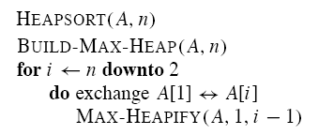

Slide 24
Example

Slide 25
Analysis
• BUILD-MAX-HEAP: O(n)
• for loop: n − 1 times
• exchange elements: O(1)
• MAX-HEAPIFY: O(lg n)
Total time: O(n lg n).

Slide 26
Heap implementation of priority queue
Heaps efficiently implement priority queues. These notes will deal with max priority queues implemented with max-heaps. Min-priority queues are implemented with min-heaps similarly.
A heap gives a good compromise between fast insertion but slow extraction and vice versa. Both operations take O(lg n) time.

Slide 27
Priority queue
Maintains a dynamic set S of elements.
• Each set element has a key-an associated value.
• Max-priority queue supports dynamic-set operations:
• INSERT(S, x): inserts element x into set S.
• MAXIMUM(S): returns element of S with largest key.
• EXTRACT-MAX(S): removes and returns element of S with largest key.
• INCREASE-KEY(S, x, k): increases value of element x’s key to k. Assume k ≥ x’s current key value.
• Example max-priority queue application: schedule jobs on shared computer.

Slide 28
• Min-priority queue supports similar operations:
• INSERT(S, x): inserts element x into set S.
• MINIMUM(S): returns element of S with smallest key.
• EXTRACT-MIN(S): removes and returns element of S with smallest key.
• DECREASE-KEY(S, x, k): decreases value of element x’s key to k. Assume k ≤ x’s current key value.
• Example min-priority queue application:
event - driven simulator.

Slide 29
Finding the maximum element
Getting the maximum element is easy: it’s the root.
HEAP-MAXIMUM(A)
return A[1]
Time: (1).

Slide 30
Extracting max element
Given the array A:
• Make sure heap is not empty.
• Make a copy of the maximum element (the root).
• Make the last node in the tree the new root.
• Re-heapify the heap, with one fewer node.
• Return the copy of the maximum element.
HEAP-EXTRACT-MAX(A, n)
if n < 1
then error .heap underflow.
max ← A[1]
A[1] ← A[n]
MAX-HEAPIFY(A, 1, n − 1) remakes heap
return max

Slide 31
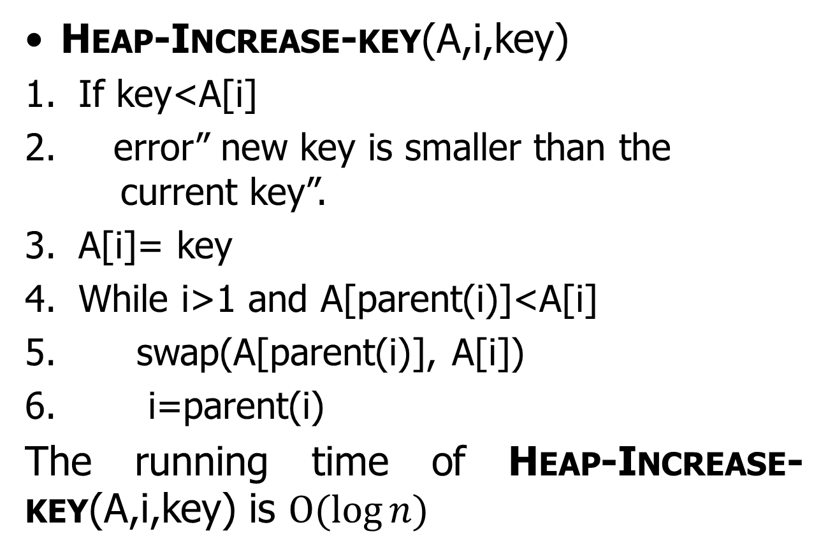
Heap-Increase-key(A,i,key)
If key<A[i]
error” new key is smaller than the current key”.
A[i]= key
While i>1 and A[parent(i)]<A[i]
swap(A[parent(i)], A[i])
i=parent(i)
The running time of Heap-Increase-key(A,i,key) is $Ο(\log{n)}$

Slide 32
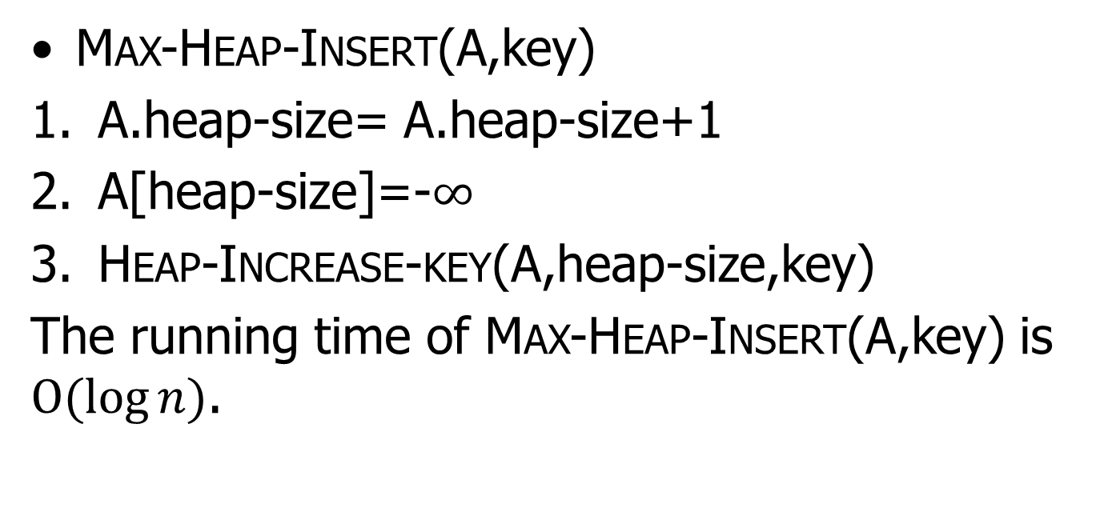
Max-Heap-Insert(A,key)
A.heap-size= A.heap-size+1
A[heap-size]=-$∞$
Heap-Increase-key(A,heap-size,key)
The running time of Max-Heap-Insert(A,key) is $Ο(\log{n)}$.

